Slide 1
Ames (IowA) housing sale price prediction model
WHAT DATA SCIENTISTS CAN DO FOR
REAL ESTATE BUSINESSES
By Djuwita Carney

Slide 2
Objectives
To create a sale price prediction model that taking into account the key variables, both qualitative and quantitative, with accurate results.

Slide 3
Who can benefit from this model?
Sellers
Buyers
Investors
Real estate agents
Mortgage companies/banks
Assessors, estimators
Etc….

Slide 4
Resources & Approach
City of Ames Housing Data base (2011)
Multi variable Linear Regression Model

Slide 5
HOW?
Test Sale Price
Exterior
Exterior
Lot Are
Above Ground Qual
Lot Are
Above Ground Qual
Pool
Pool
Sale Price
'Central Air
Ovrall_Quality
Ovrall_Quality
Bed_rooms
street
Bed_rooms
street
'Garage Cars'
Foundation
'Garage Cars'
Foundation
Bath_room
Year Built
Bath_room
Year Built
'Gr Liv Area
Sale Price Model Prediction
'Gr Liv Area
Electrical
Electrical
Garage
Basement
Garage
Basement
'Garage Finish
Functional
Exterior Qualit
Exterior Qualit
Functional
Heating
Heating
Roof Material
Roof Material
Fence
Fence
Kitchen Quality
'2nd Flr SF
Kitchen Quality
'2nd Flr SF
Undergeound Quality
Year Sold

Slide 6
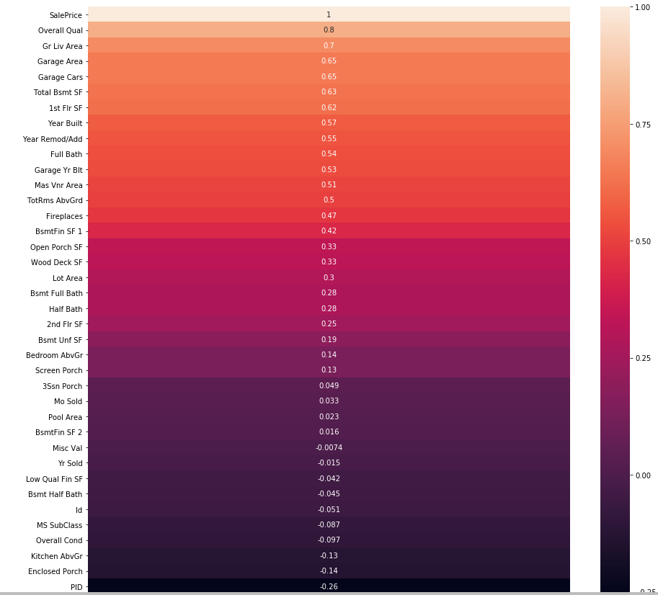
Correlation Coefficients

Slide 7
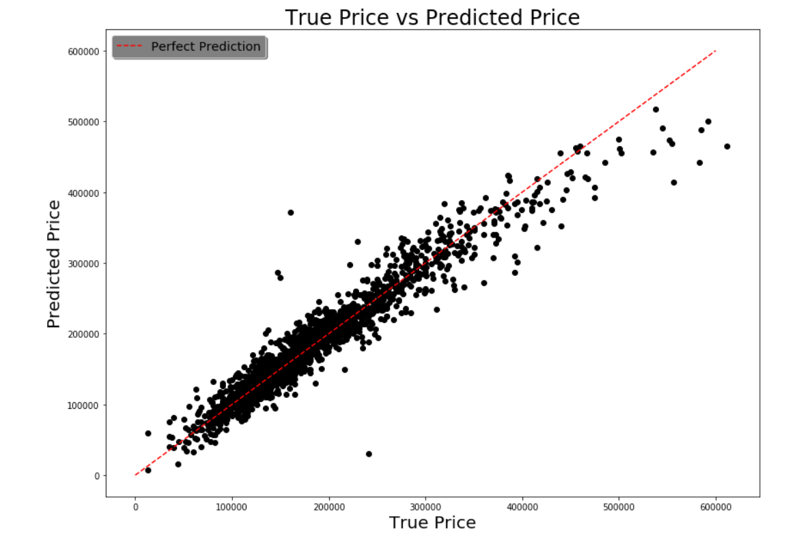

Slide 8
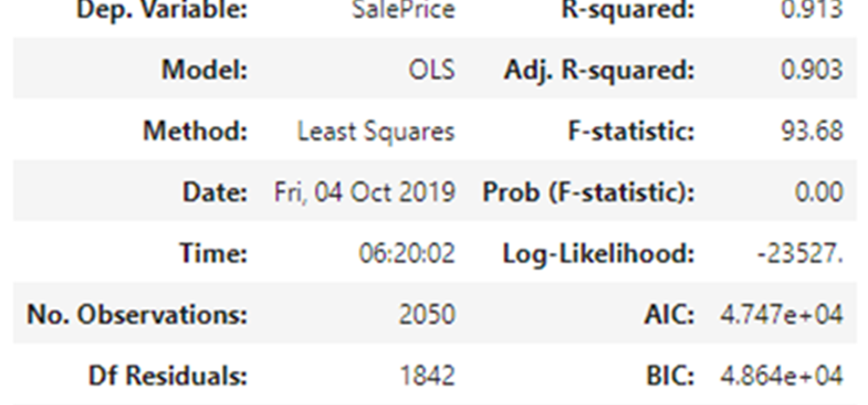

Slide 9
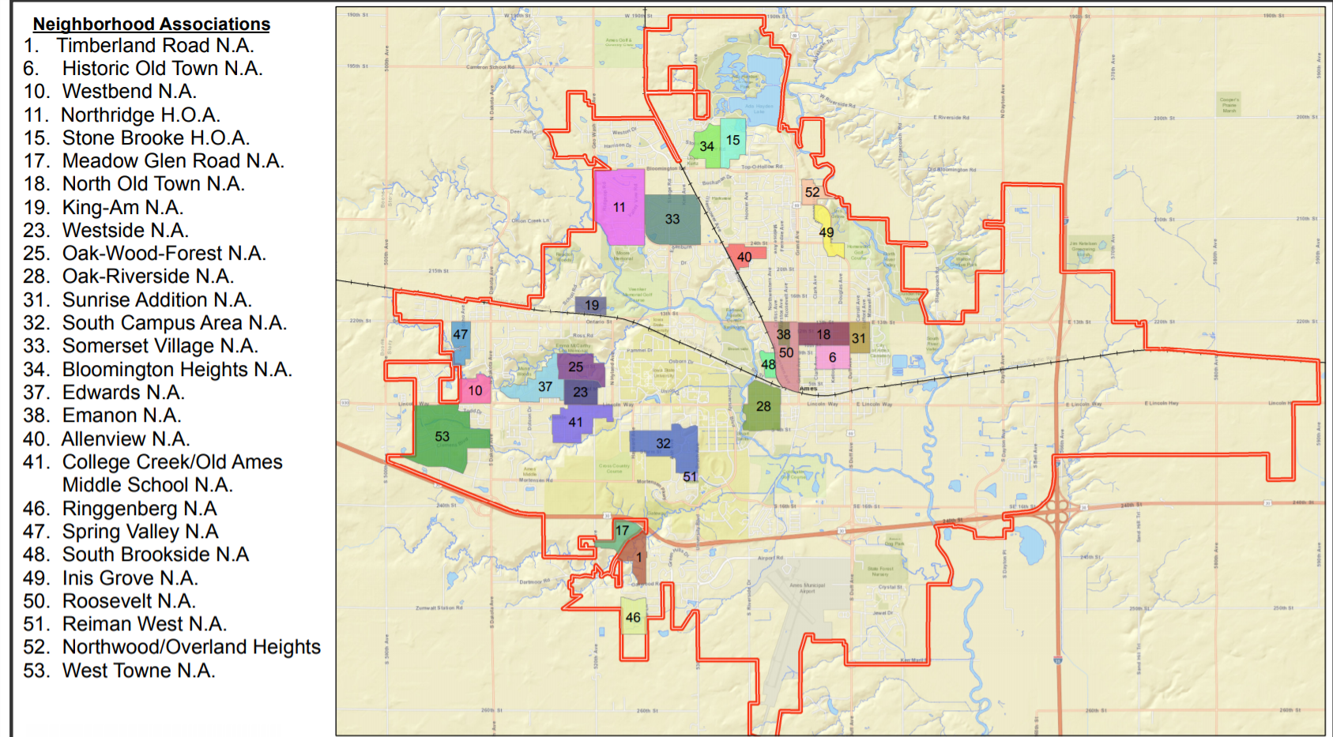

Slide 10
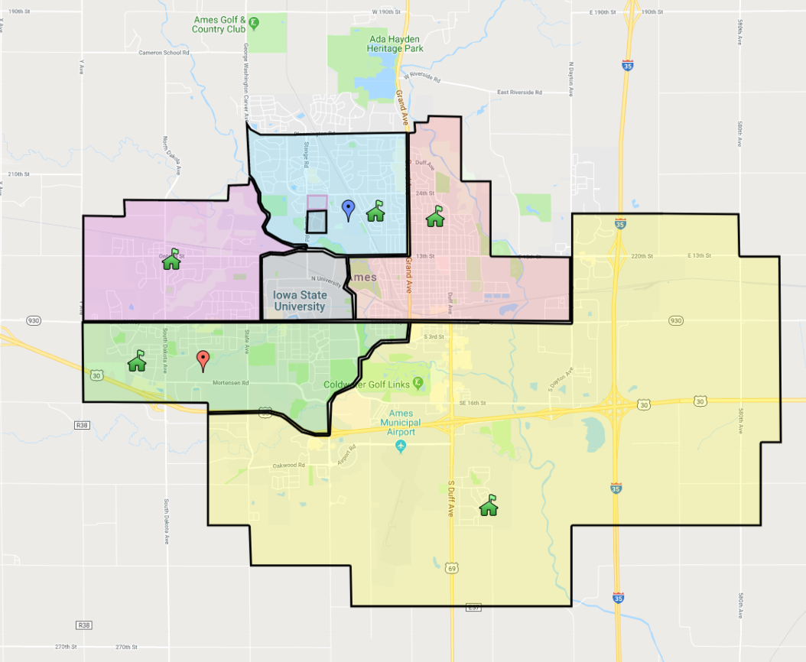
Ames School District Map

Slide 11
['Sawyer', 'SawyerW', 'NAmes', 'Timber', 'Edwards', 'OldTown', 'BrDale', 'CollgCr', 'Somerst', 'Mitchel', 'StoneBr', 'NridgHt', 'Gilbert', 'Crawfor', 'IDOTRR', 'NWAmes', 'Veenker', 'MeadowV', 'SWISU', 'NoRidge', 'ClearCr', 'Blmngtn', 'BrkSide', 'NPkVill', 'Blueste', 'GrnHill', 'Greens', 'Landmrk']
Neighborhoods available in the DataBase
'Sawyer', 'SawyerW', 'NAmes', 'Timber', 'Edwards', 'OldTown',
'BrDale', 'CollgCr', 'Somerst', 'Mitchel', 'StoneBr', 'NridgHt',
'Gilbert', 'Crawfor', 'IDOTRR', 'NWAmes', 'Veenker', 'MeadowV',
'SWISU', 'NoRidge', 'ClearCr', 'Blmngtn', 'BrkSide', 'NPkVill',
'Blueste', 'GrnHill', 'Greens', 'Landmrk'

Slide 12
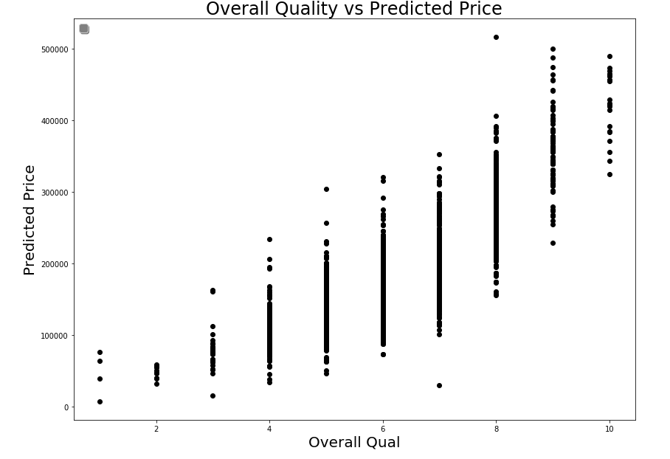

Slide 13
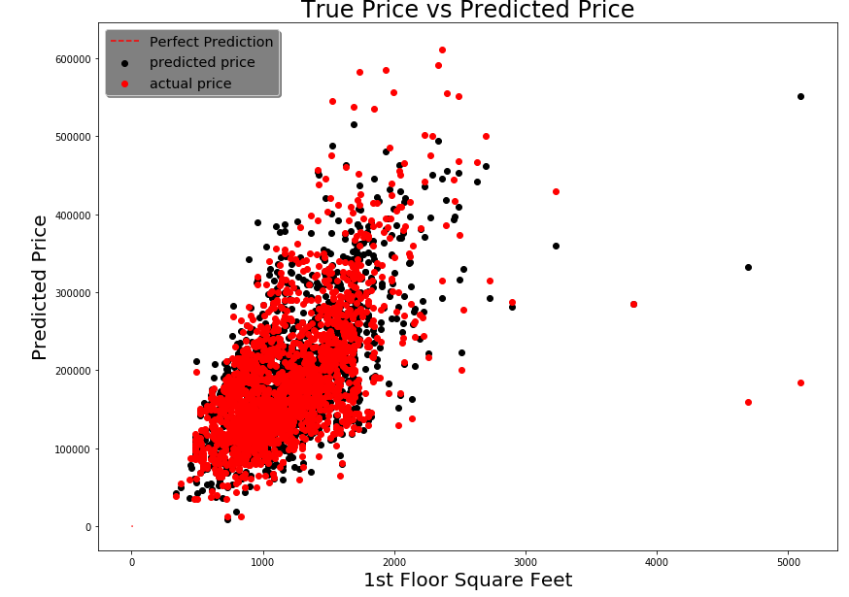

Slide 14
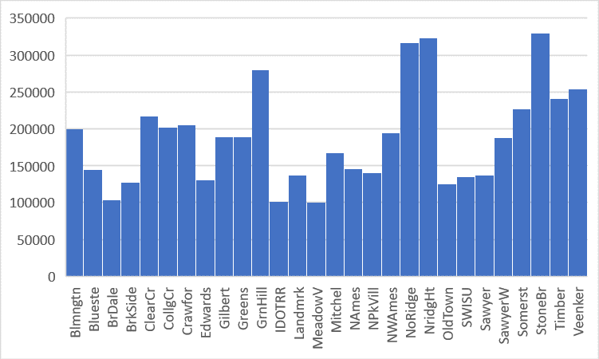
Sale Price
Neighborhoods

Slide 15
Conclusions & Recommendations
Conclusion:
The Ames Housing Database is good enough for creating a model to predict Sale Price
More features such as neighborhood school will be very useful to improve the Database
Adding more neighborhood to the database
Recommendations :
Overall condition of the house is very important
Having finished basement is also a good way to increase the price
Similarly, exterior condition of the house is an important aspect to the price
Stonebridge neighborhood has the highest average, good investment

